Slide 1
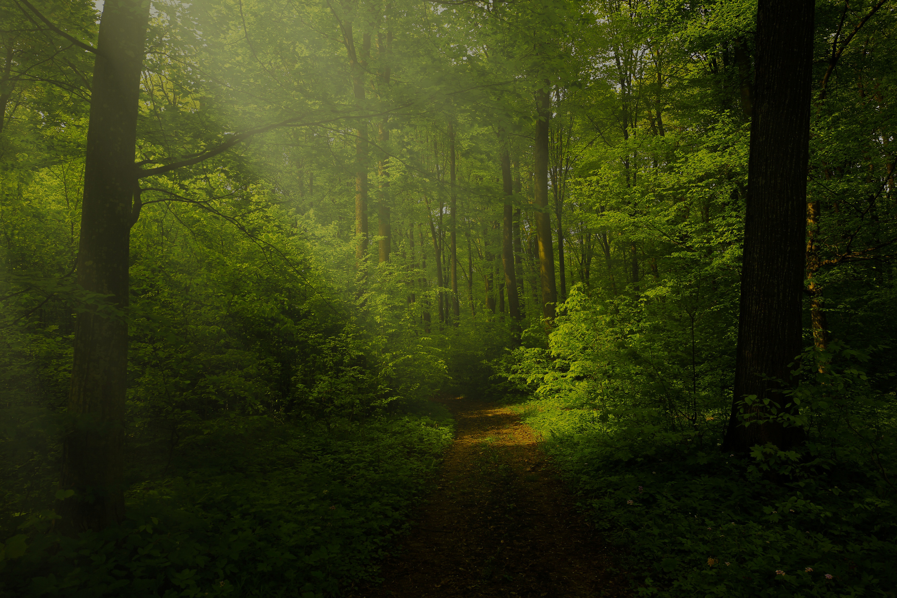
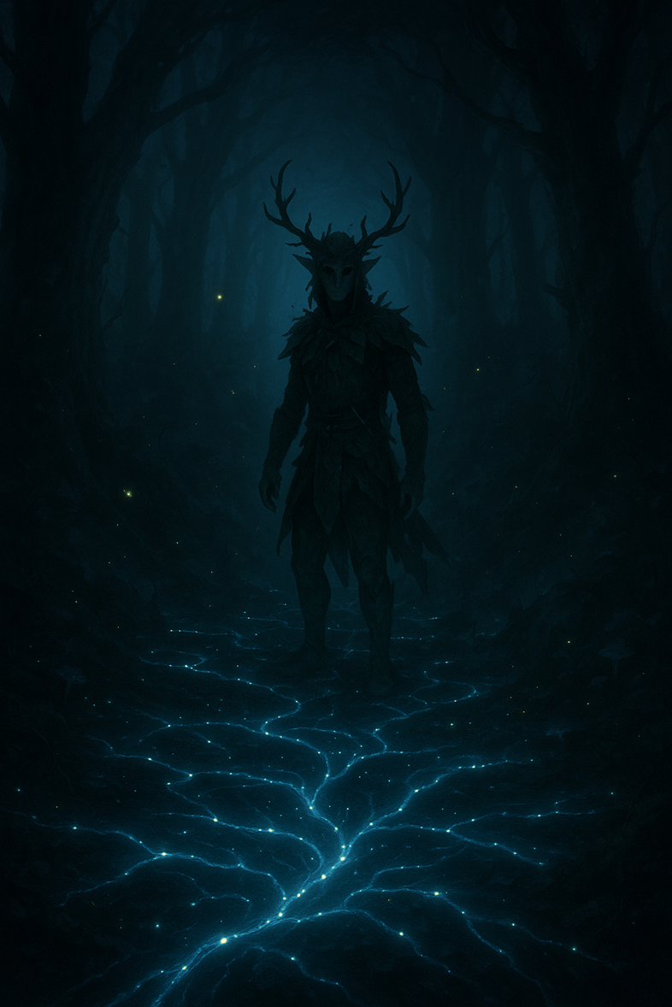
UDRUM & FOREST
“Save the forest and reconnect the soul of the forest.”

Slide 2
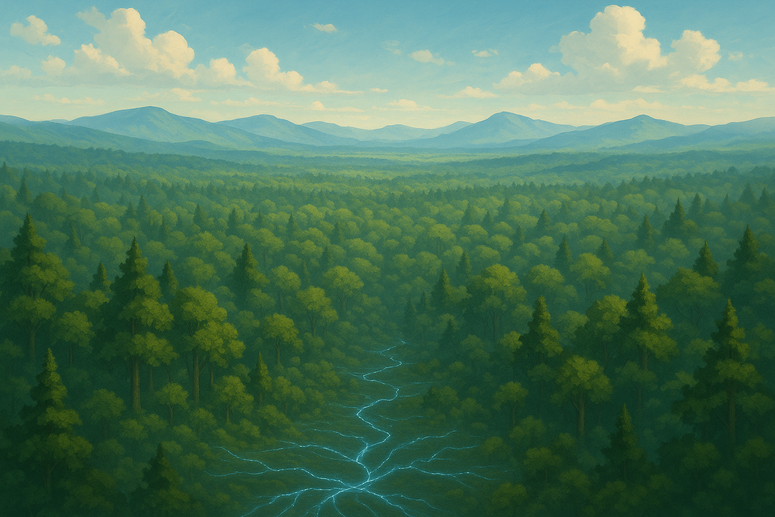
OVERVIEW
<< Stay connected with the forest and save it from danger >>
Udrum, a sylvan creature, is the guardian of the forest who will defend his environment from unconscious actions of man.
inspired by Trentino folklore

Slide 3
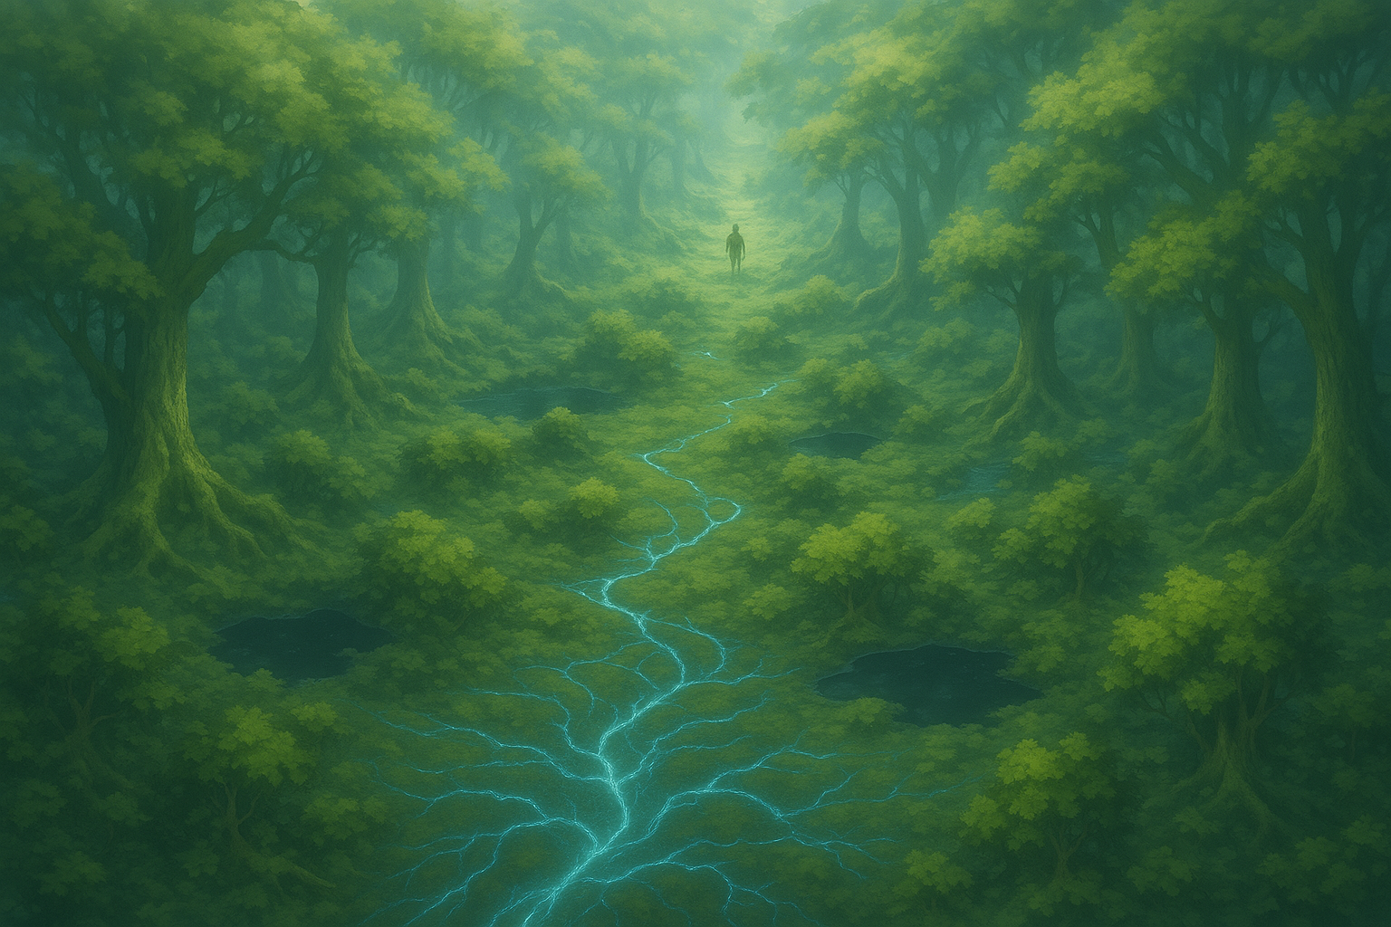
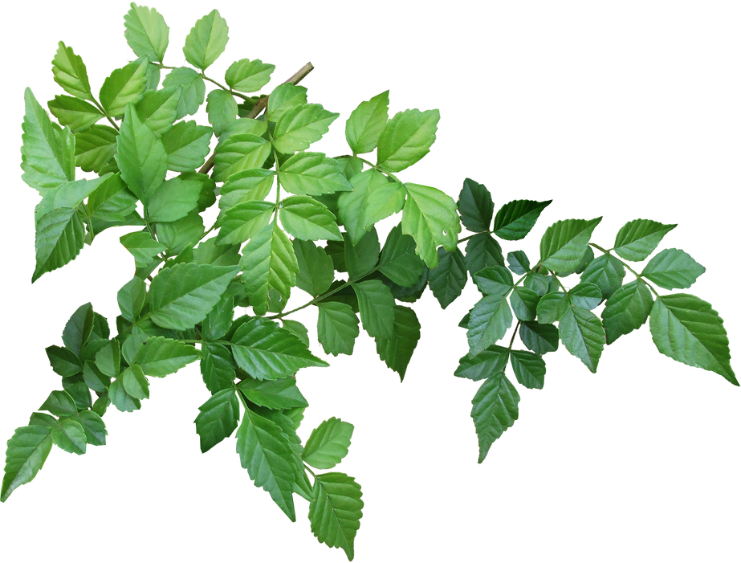
GAME SHEET
Technical data sheet
Genre
Open World Exploration Adventure in first person camera with Environmental Puzzles
Platform
PC-Windows OS
Game Mode
Single Player
Main Tech
UNITY
Key Market
UE
Business Model
Buy to Play
Languages
IT + EN
Price
19.90 Euro

Slide 4

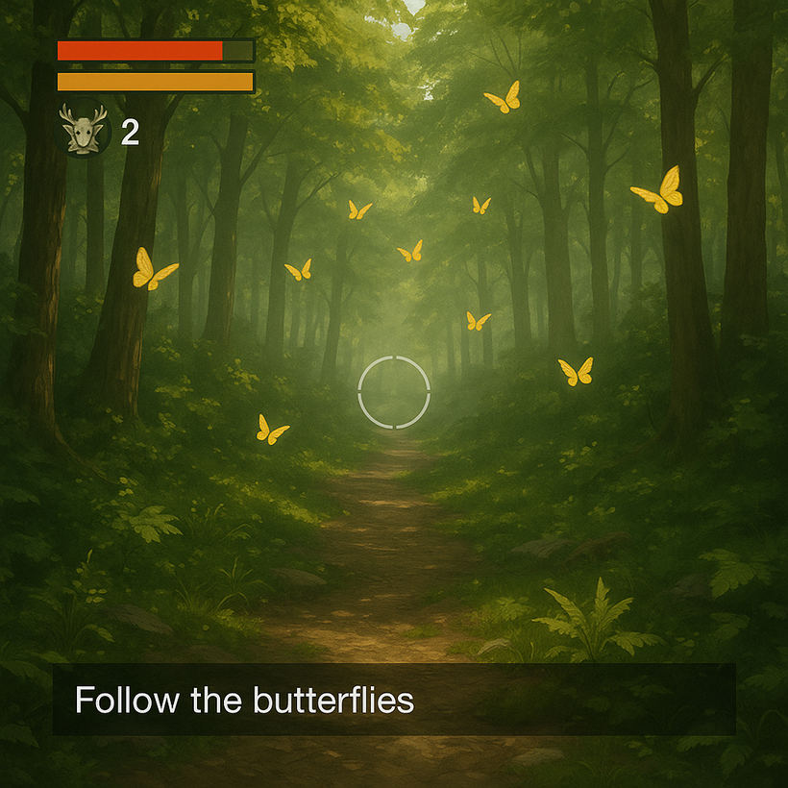
GAME CONCEPT
First-person gameplay, featuring environmental puzzles and narrative missions. The player moves freely through the forest, where every action consumes energy or stamina, encouraging a thoughtful and strategic approach.
• Purification – Interact with mycelium to cleanse corrupted areas.
• Liberation – Rescue trapped animals through environmental puzzles.
• Skill Check – Timed events that require precision to overcome environmental challenges.
• Mycelic Perception – Sensory modality that reveals hidden connections and paths.
• Natural Guidance – Butterflies by day and fireflies by night show the way.
• Ecological Morale – Every action visually and audibly influences the game world.
• Move Objects – You can grab and move object in the enviroment for overcome obstacles and continue in your mission.

Slide 5
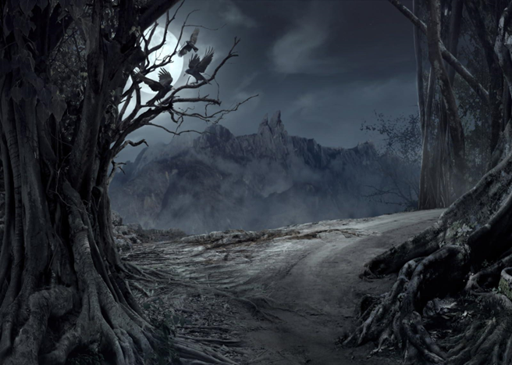
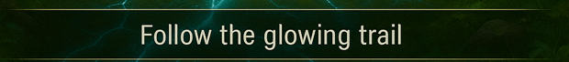
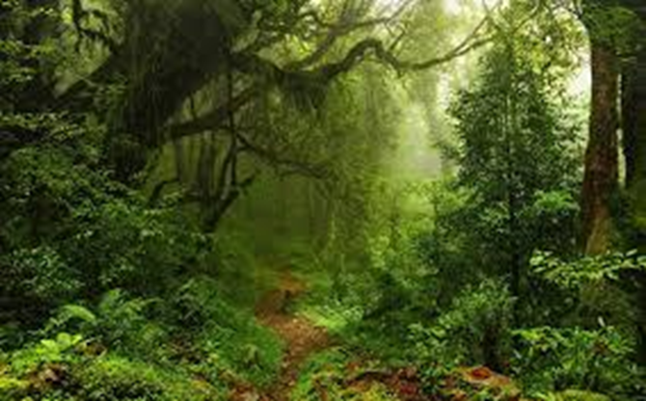
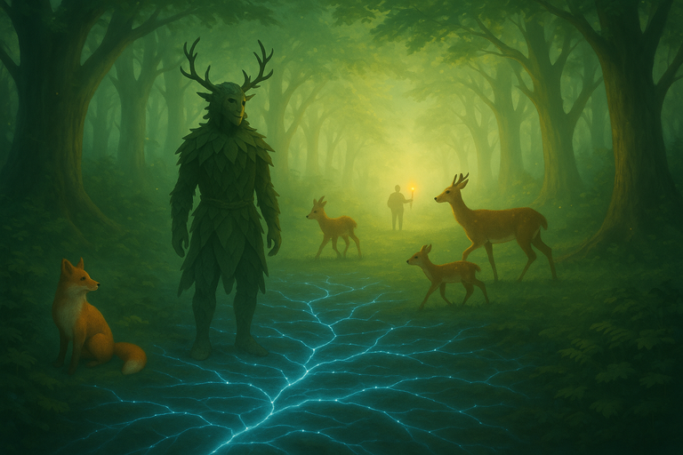
OTHER THINGS
You are Udrum the guardian of the forest will defend its environment at all costs. Use mycelial network and following fireflies at night and butterflies during the day go to reach the point of interest at the moment.
All events are reported in the messages bar at the bottom of the HUD.
In the game you can make rescue missions or mitigation actions to restore the natural balance, which become gradually more difficult.
Thanks to your interventions, nature awakens and the animals in the forest increase.

Slide 6
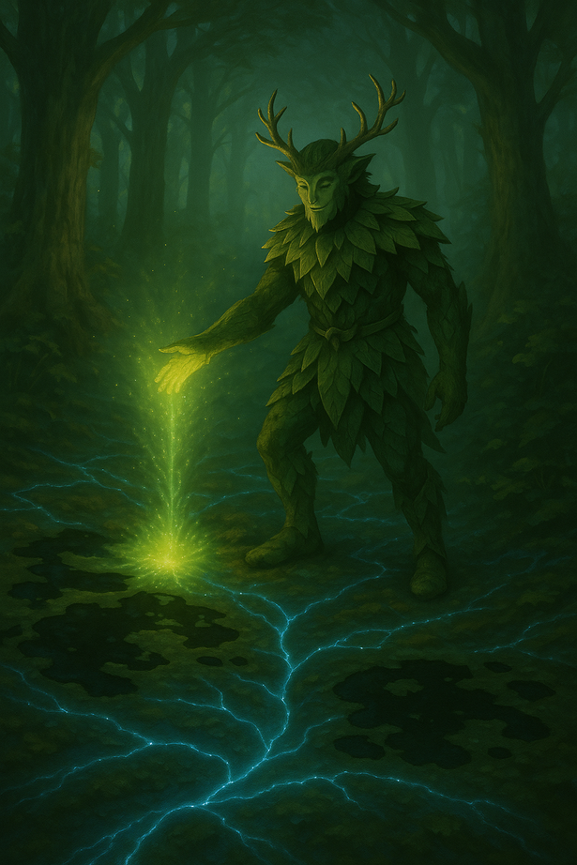
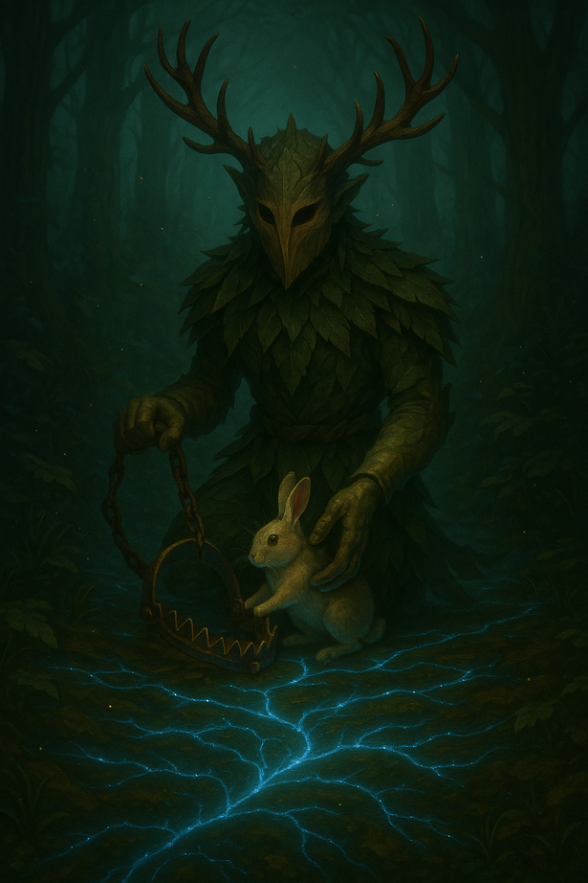
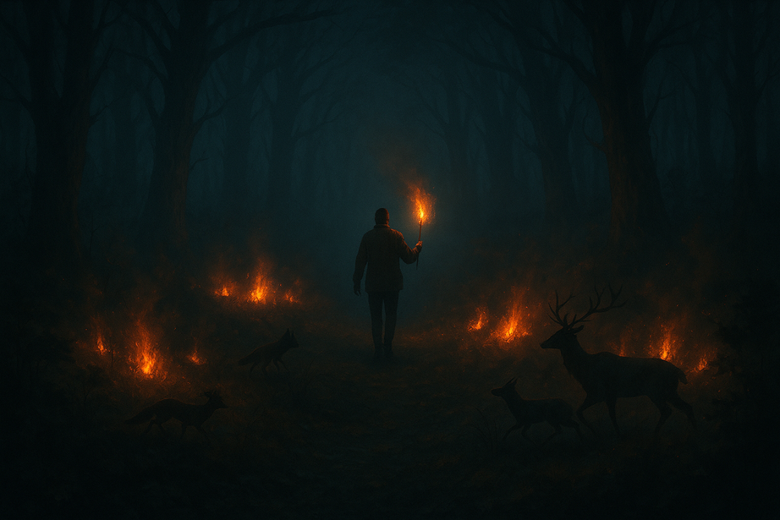
ENVIRONMENTAL ISSUES
protect the forest from fires
clean up the forest from polluted pools
free animals from traps

Slide 7
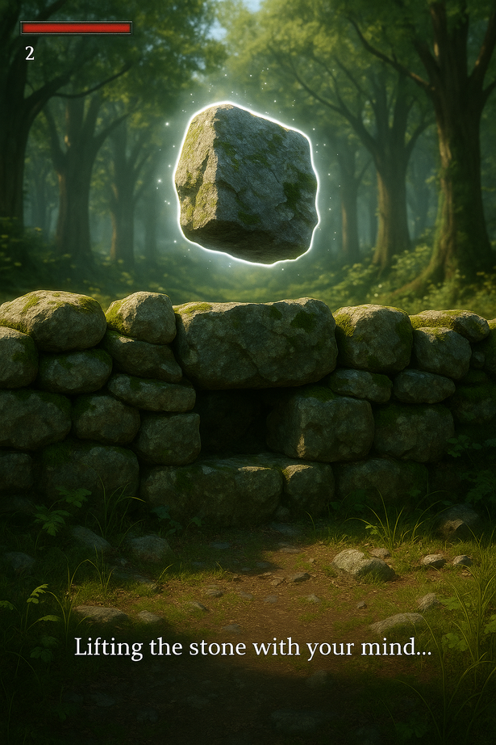
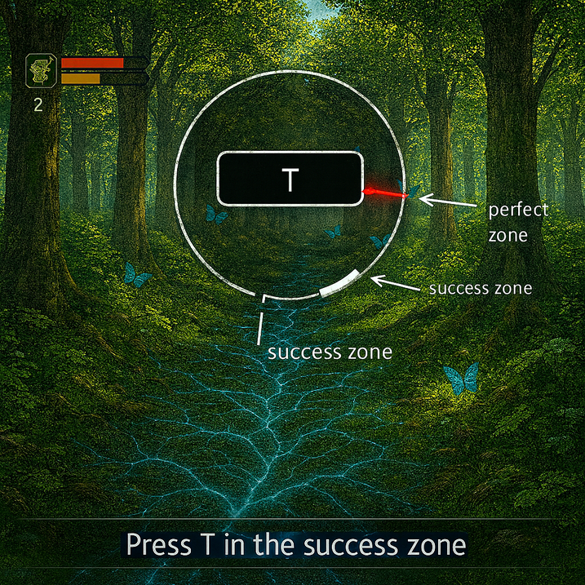
GAMEPLAY - MECHANICS
SKILL CHECKS allow the player to solve environmental problems by winning skill check 3 times consecutively.
you can grab and move object in the enviroment using telecinesis.
you can rotate objects in the enviroment by hold the right mouse button and moving mouse.
you can shoot objects in the enviroment by pressing left mouse button.
by telecinesis you can resolve environment issues too.

Slide 8
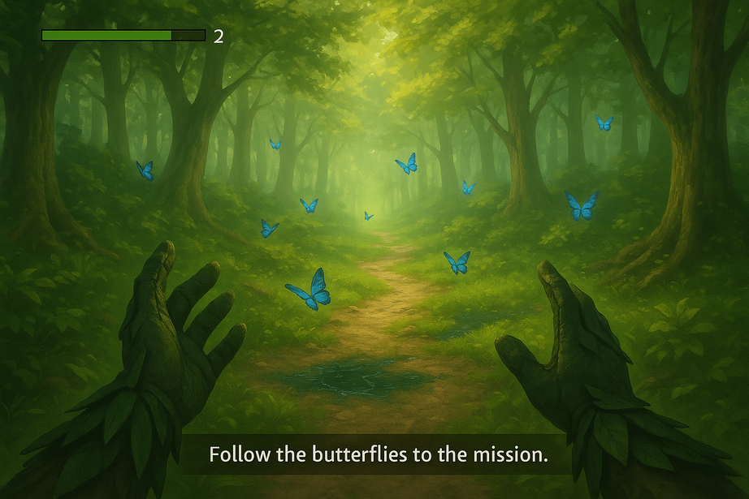
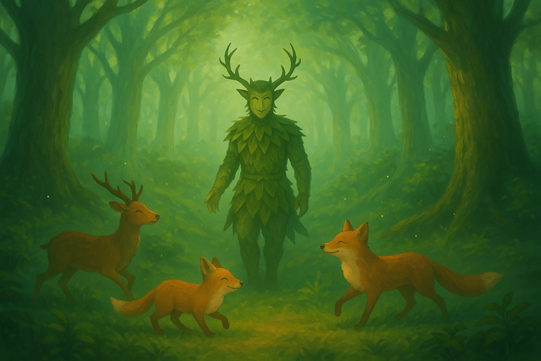
GAME LOOP
START
FOREST MYCELIUM NOTIFIES PROBLEM TO PLAYER
Reduce paper waste
FOLLOW BATTERFLIES OR FIREFLIES
PERFORM 3 SKILL CHECKS
success ??
yes
no
RESTART
YOU LOST

Slide 9
PILLARS
1. Guided Exploration (Diegetic Navigation)
Why: The player must reach Points of Interest (POIs) without intrusive UI or mini-maps.
How: Use butterflies (day) and fireflies (night) as natural guides; glowing mycelium threads subtly indicate direction.
2. Focus-Based Skill Checks
Why: Adds short, tense, skill-based interaction moments that fit the theme of precision and care.
How: Single-button input (“T”), visible success zone, difficulty scales with arrow speed and window size.
Success Metric: Average success rate: 70% at early levels → 55% at advanced levels; clear audiovisual feedback for success/failure.

Slide 10
KEY SELLING POINTS
Core Moral / Message
Short version (for a tagline): Respect the forest, and it will guide you back
to balance.
there are the possibilities to have funds or sponsorships from green organizations or european institutions.
the strong point is the social and educational purpose that a game like this can have while respecting the environment.

Slide 11

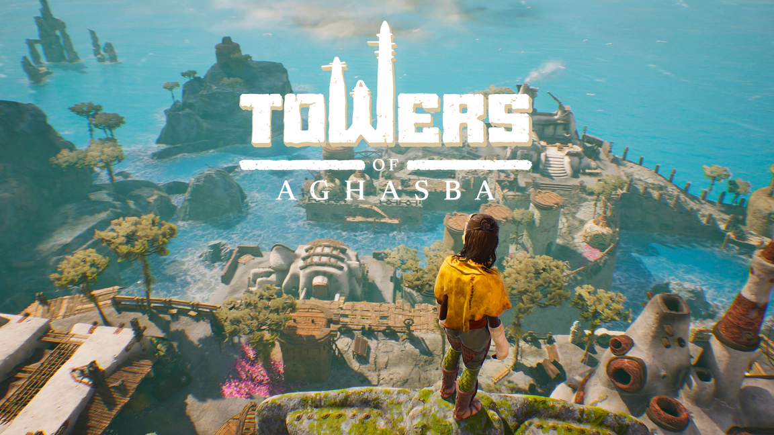
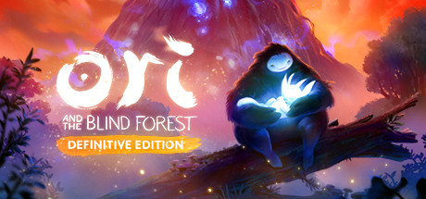
CREATIVE MIX
ispired by various
legends of Nordic folklore.
16,79€
Open World Game in the natural environment
young hero save the forest that was dying
19,99€
28,99€

Slide 12
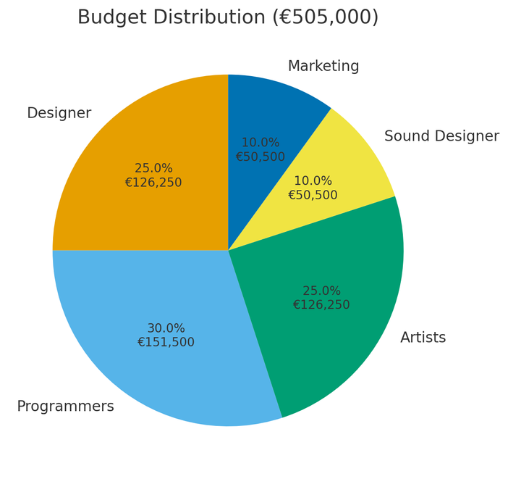
FINANCIAL PROJECTION
BUDGET : 505 000 €
GAME PRICE: 19,90 €
DESIGNER : 25%
PROGRAMMERS : 30%
ARTIST: 25%
SOUND DESIGNER: 10%
MARKETING : 10%
BREAK-EVEN: 36300 copies

Slide 13
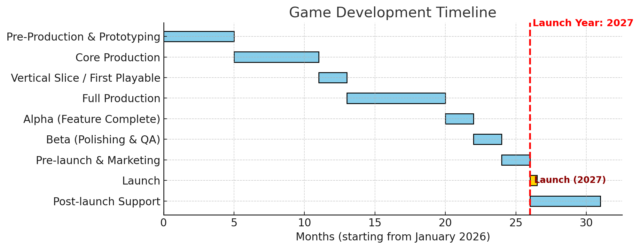
TIMELINE

Slide 14
TEAM
GAME DESIGNER
To be recruited
PROGRAMMERS
Andrea Fraboni
To be recruited
ARTISTS
To be recruited
To be recruited
SOUND DESIGNER
To be recruited

Slide 15
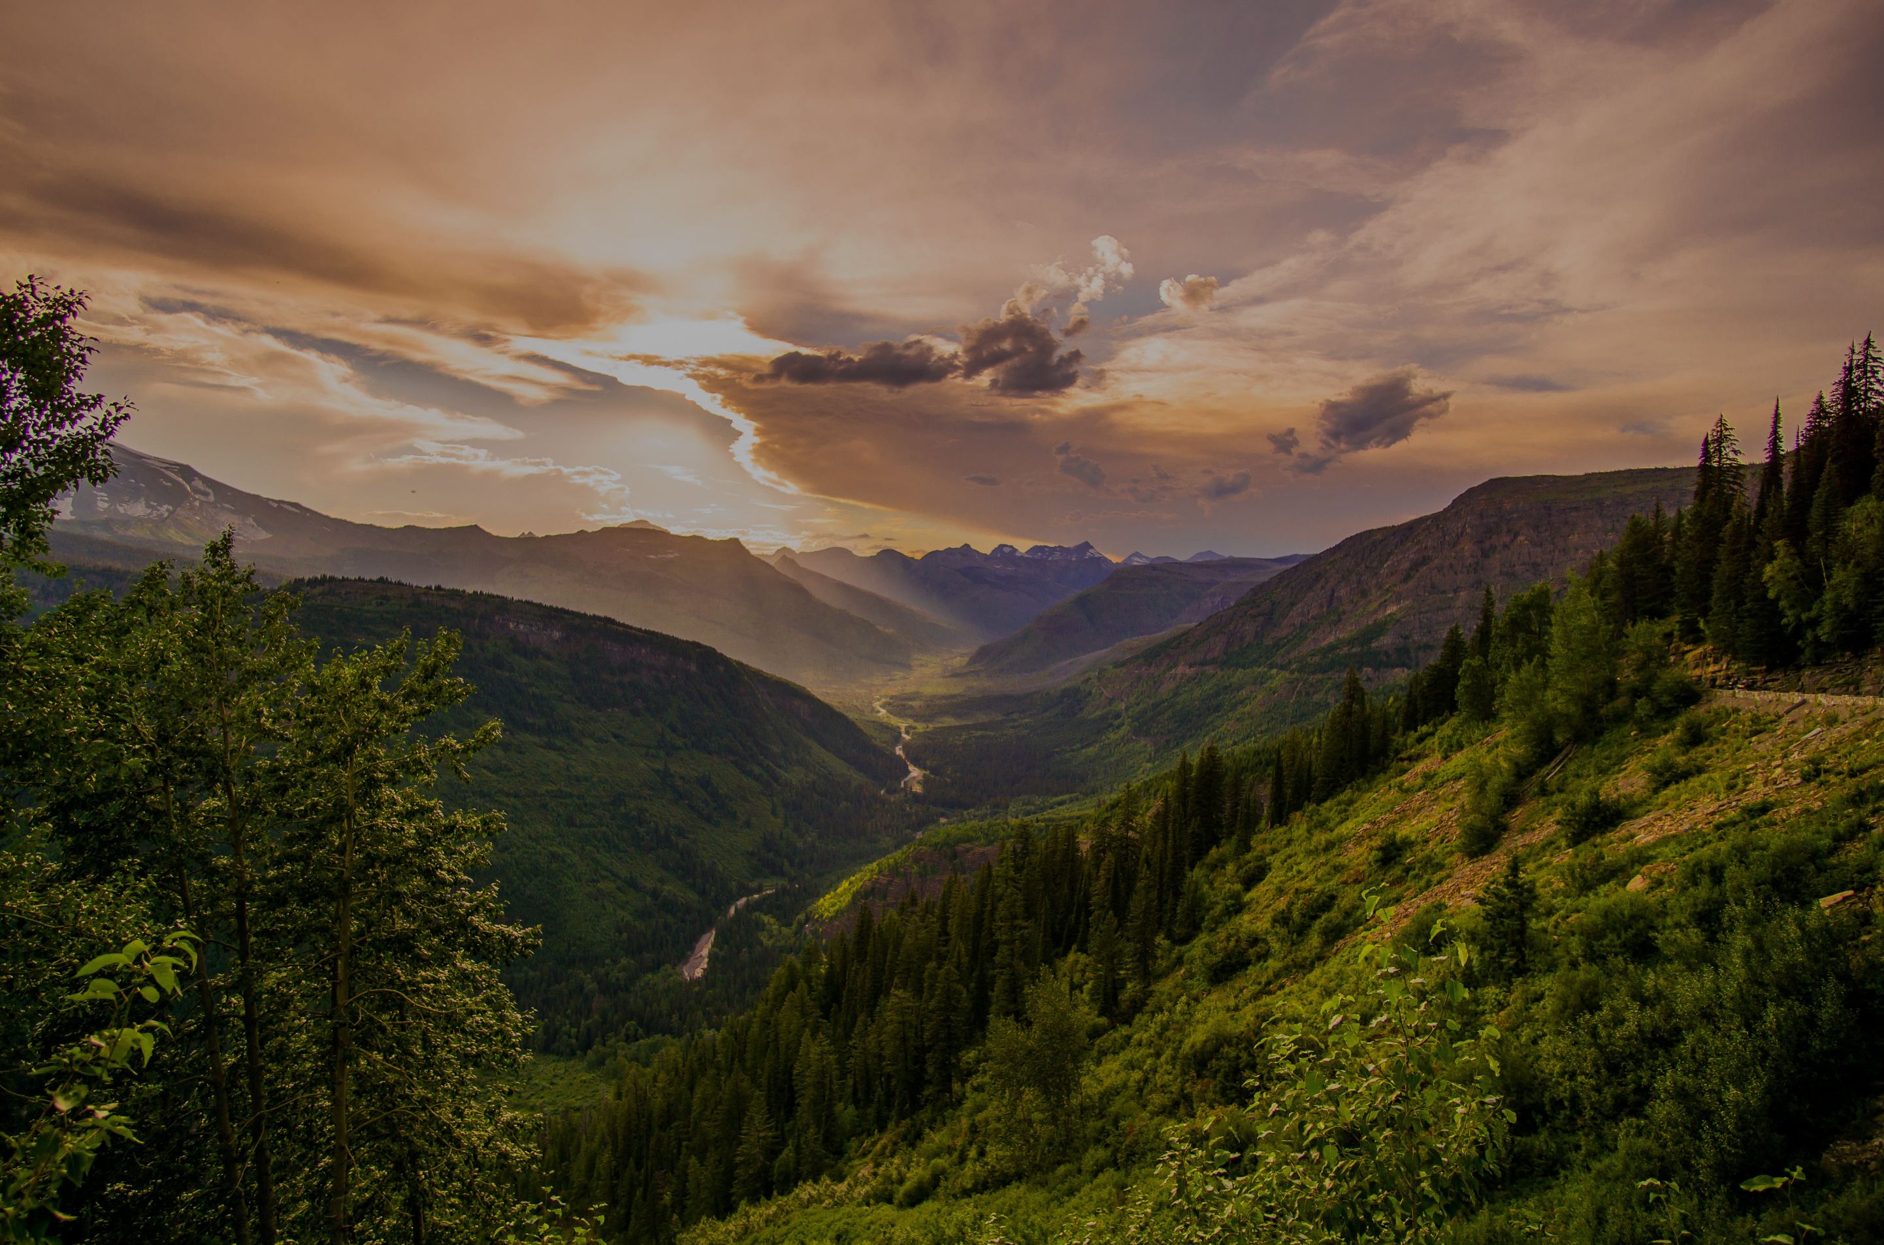
THANK YOU
Let’s keep our Earth green and alive

